Slide 1
Fundamentals of U.S. Health Care:
An Introduction for Health Professionals
By
Jahangir Moini, M.D., M.P.H.
and
Morvarid Moini, D.M.D., M.P.H.

Slide 2
Unit I
Health care today

Slide 3
Chapter 1
The complexity of health care

Slide 4
Overview
Health care is more complex
Most patients have a primary care physician, who refers them to specialists
There are more health facilities available
Many people cannot access them

Slide 5
U.S. health care
Most diseases are related to lifestyle:
  Diet
  Exercise
  Hygiene
  Habits (smoking, drinking)
Chronic illnesses (hypertension, diabetes, etc.) are more common than communicable illnesses

Slide 6
U.S. health care
Infectious disease was the most common cause of death
This has changed because of:
  Antibiotics
  Vaccinations
  Better hygiene
  Clean water
  Food preparation
  Improved nutrition
  Better medicines, medical techniques

Slide 7
U.S. health care
With aging, non-communicable diseases became more prevalent
Chronic disease processes begin long before symptoms appear
The focus of today’s health care is on disease prevention

Slide 8
U.S. health care
Insurance pays for acute disease treatments and hospitalization
Most insurers cover short-term, specialized services (cardiac care, surgery)
Resources must be redistributed toward disease prevention!

Slide 9
U.S. health care
Preventive efforts help detect diseases earlier
Leading causes of death:
  Heart disease
  Cancer
  Stroke
  Alzheimer’s disease
  Chronic lower respiratory disease
Poorer people are less healthy overall

Slide 10
Health care industry
Tremendous growth occurring in:
  Physician’s offices
  Hospitals
  Nursing homes
  Insurance companies
  Assisted-living organizations
  Pharmaceutical companies
  Equipment manufacturers

Slide 11
Health care industry
The elderly need more care, and spend more money for it
Over age 80, three of four people have more than one chronic disease
Ages 65–80: two of three people have more than one chronic disease

Slide 12
Fastest growing segments of the health care industry
Home health aids 56%
Medical assistants 52%
Physician assistants 50%
Physical therapist assistants 44%

Slide 13
U.S. health care industry
Largest service industry
Before the Affordable Care Act (ACA), 42 million people were uninsured (13.4% of population)
Medical care cost $3.8 trillion in 2015

Slide 14
Technological advancements
Medical technology: applying scientific knowledge to improve health care
Advancements:
  Laser surgery
  Telemedicine
  Electronic medical records
  Magnetic resonance imaging (MRI)
  Computed axial tomography (CAT)
  E-prescribing
  Robotic surgery
  Organ transplants

Slide 15
Technological advancements
Sustaining life artificially is very expensive
Health care expenses increased the government’s power over provision of care

Slide 16
Technological advancements
Nanomedicine: uses nanotechnology, manipulating atoms and molecules
  Nanoparticles can carry drugs to specific body regions, to fight cancer
Other developments:
  Gene therapy
  Robotic and microscopic surgery
  Targeted drug therapy
  Information technology

Slide 17
Examples of medical technologies
Curative: joint replacement, transplantation
Diagnostic: blood pressure (BP) monitors, CT scans, electrocardiography, MRI
Disease management: pacemakers, angioplasty, dialysis
Facilities, clinics: labs, “satellite” centers, home health care, subacute care

Slide 18
Examples of medical technologies
Life-saving measures: marrow transplantation, CPR, intensive care units (ICUs)
Organizational delivery: integrated networks, managed care
Preventative: diets, implantable defibrillators, vaccines, immunizations
System management: health information systems, telemedicine

Slide 19
Specialization
120+ specialties and subspecialties
Many professionals treat only one aspect of a patient’s condition
Other negative factors:
  Increased costs
  Poorer patient–provider relationships

Slide 20
Specialization
8 major areas:
  Emergency medicine
  Family practice
  Internal medicine
  Obstetrics-gynecology
  Orthopedic surgery
  Pediatrics
  Psychiatry
  General surgery

Slide 21
Specialization
Specialists not distributed equally through the country (more are in major cities)
42% of physicians are primary care (declining continually for 70+ years)
58% are specialists

Slide 22
Highest paying medical specialties
Invasive cardiologists $525,000
Orthopedic surgeons $497,000
Gastroenterologists $455,000
Urologists $412,000
Dermatologists $398,000
Emergency physicians $345,000
General surgeons $339,000

Slide 23
Costs
Cost is the primary factor in lack of coverage:
  Inflation
  Third-party payers
  Fraud, abuse
  Defensive medicine
  Technology
  Elderly
  Market problems
  Delivery of care
  Administration
  Multi-payer system
  Practice variations
  Equipment, supplies
  More tests, treatments
  Lawsuits

Slide 24
Costs
Total direct costs from malpractice liability = $35 billion per year
This results in increased prices
Defensive medicine: procedures that reduce likelihood of legal outcomes

Slide 25
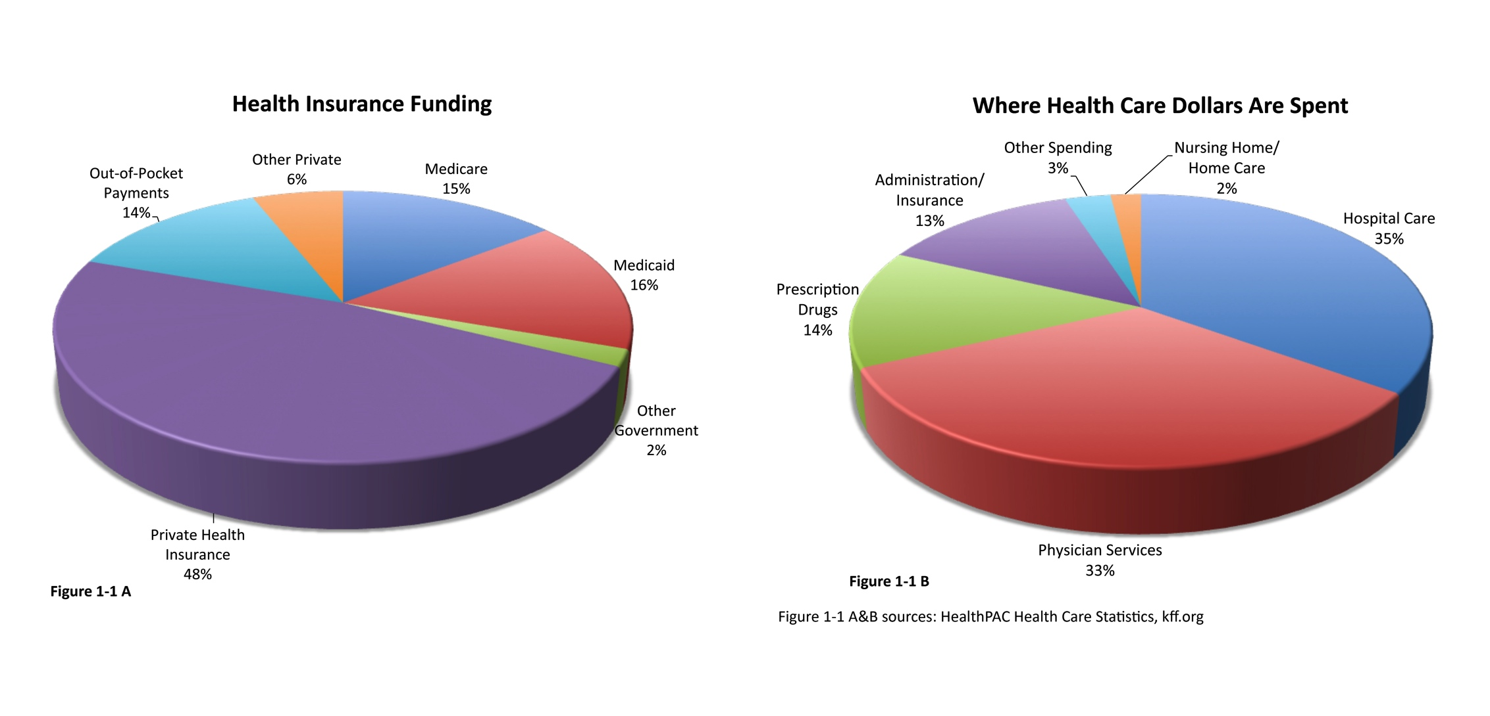
Figure 1-1: (Part A: health insurance funding)
(Part B: where health care dollars are spent)

Slide 26
Costs
Fraud and abuse: illegal claims, cost reports, upcoding (billing for higher priced services than actually provided)
Medical model: interventions emphasized after patients become sick
Practice variations: differing treatments for similar patients

Slide 27
The aging population
Advances = Americans living longer
More years in worse health, requiring care for:
  Alzheimer’s disease, dementia
  Diabetes
  Hypertension, stroke
  Cancers
  Osteoporosis, fractures
  Hearing & visual impairments

Slide 28
U.S. life expectancy based on birth year
 | Males | Females | Total
1900 – Average White Black | 40 47 33 | 41.5 49 34 | 40.7 48 33.5
2000 – Average White Black | 71.5 75 68 | 77.5 80 75 | 74.5 77.5 71.5
2010 – Average White Black | 76.4 78.5 71.4 | 81.1 83.8 77.7 | 78.8 81.2 74.7

Slide 29
The aging population
More than 44.7 million (14.1% of population)
Baby boom generation: now reaching age 65
In under two decades, elderly will be more than 26% of population
Baby boomers: due to large number of births between 1946 and 1964

Slide 30
The aging population
Significant growth in elderly services:
  Long-term care
  Home health care
  Adult day care (adult day service; helps elderly, so their adult children can maintain their careers)

Slide 31
Health care services
Better options:
  Inpatient, rehabilitation hospitals
  Post-acute brain injury facilities
  Outpatient, ambulatory care hospitals
  Long-term care facilities
  Mental health facilities
  Home health care, hospice
  Government health services

Slide 32

Figure 1-2: Various health care professionals employed in different types of facilities

Slide 33
Hospitals
Inpatient services = largest share of total expenditures
Employment is continually increasing
Hospitalizations occur less often, and for shorter periods of time
Fewer than 6,000 registered hospitals

Slide 34
Hospitals in the United States
5,686 registered hospitals
3,003 urban community hospitals
1,971 rural community hospitals
3,144 community hospitals in “systems”
1,582 community hospitals in “networks”
35,416,020 total admissions
$859,419,233,000 total expenses

Slide 35
Hospitals
Less common types:
  Psychiatric
  Federal
  Non-federal long-term
  Teaching
  Non-teaching

Slide 36
Hospitals
Medicare and Medicaid pay for most stays
Most are “private, non-profit, general hospitals”: patients have short stays
General hospitals: provide varied services
Often seek accreditation through The Joint Commission, to maintain quality of care

Slide 37
Hospitals
Types of care:
  Emergency (immediate attention)
  Trauma (life-threatening injuries)
  Cardiac care units (CCUs, serious heart conditions)
  Intensive care units (ICUs, serious conditions)
  Transitional care units (TCUs, lower level care)
  General care units (GCUs, seriously ill patients not needing special equipment or ongoing nursing)

Slide 38
Post-acute brain injury facilities
824 of every 100,000 people have a traumatic brain injury annually
More occurrences, but less deaths
Post-acute: care following hospitalization
May help recovery or coping skills once continued hospitalization is no longer needed

Slide 39
Ambulatory centers
Ambulatory care = outpatient care
Services provided when overnight stays are not required
Same-day surgeries performed in ambulatory surgical units, ambulatory surgical centers
Patients often discharged in 1–3 hours

Slide 40

Figure 1-3: Ambulatory surgical center

Slide 41
Ambulatory centers
Hospital-based or non-hospital-based
Most services still occur in physician offices
Surgeries often performed outside of hospitals
Wellness center: physicals, immunizations, preventive measures, education

Slide 42
Ambulatory centers
Urgent care: walk-ins for acute illnesses, injuries that primary practices or retail clinics cannot handle
No appointments needed
No ongoing care for chronic conditions
Retail clinics: may be part of pharmacies or even supermarkets

Slide 43
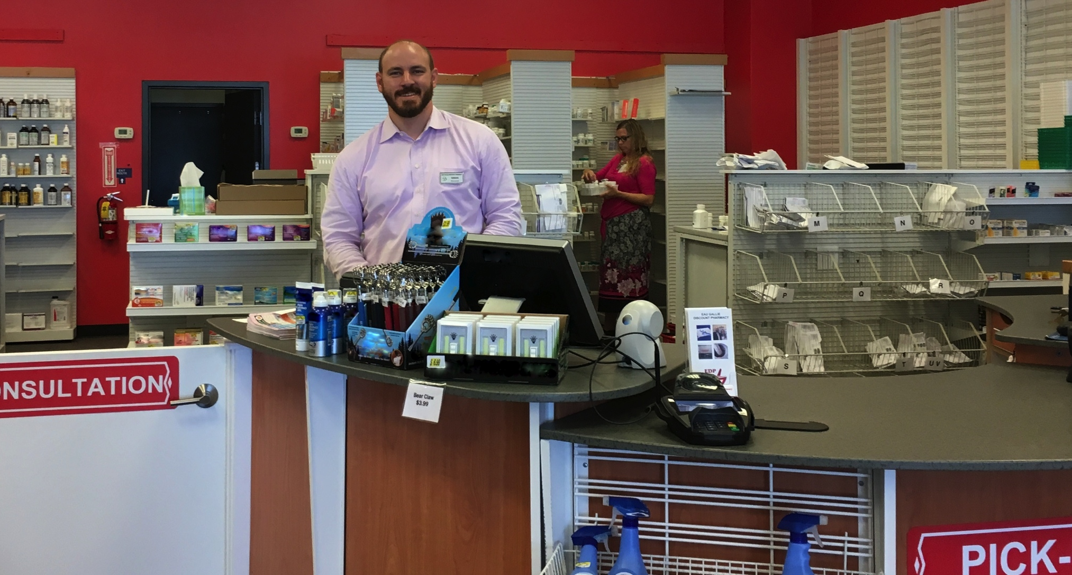
Figure 1-4: Retail pharmacy

Slide 44
Home health care
Provides services in patients’ homes
Conducted by home health agencies
More than 12,200 in U.S.
Many hospitals have home health departments focusing on rehab and post-acute care
Jobs are increasing very quickly
Services are strictly regulated

Slide 45
Long-term care facilities
Custodial care for prolonged illnesses or chronic disabilities
Mostly used by the elderly
Three in four elderly Americans will need long-term care
  Due to reduced functionality, from chronic conditions, including cognitive impairment

Slide 46
Long-term care facilities
By 2050, about 27 million will use long-term care services (doubled since 2000)
Two-thirds of costs paid by Medicaid, public sources
Holistic health care stressed
  Addresses physical, mental, social, spiritual needs

Slide 47
Long-term care facilities
Skilled nursing facilities: around-the-clock nursing and rehab
Intermediate nursing care: not 24-hour, but provides nursing, personal care, social services
Assisted-living facilities (ALFs): housing, meals, personal care (not daily nursing care)
Continuing care communities: flexible, provide required living accommodations

Slide 48
Long-term care services
Medical services | Other services
Nursing | Mental health
Rehabilitation | Dementia
Prevention and therapeutic care | Social support
Informal and formal care | Short-term respite care in a facility outside the home
End-of-life care | Community-based and institutional services Housing

Slide 49
Long-term care facilities
Newer options:
  Adult foster care (domiciliary care): small homes run by families, providing supervision and care
  Senior centers: meals, health and wellness programs, counseling, information, referrals, recreation, health screening

Slide 50
Rehabilitation hospitals
Care for stabilized patients still needing inpatient care
Amputation or traumatic injury usually requires time to regain function, adjust to support devices or prosthetics
May also focus on drug or alcohol addiction rehabilitation

Slide 51
Breakdown of patients seeking addiction rehabilitation
Type of addiction | Percentage of patients
Alcohol | 41.4%
Opiates, including heroin | 20%
Marijuana | 17%
Smoked cocaine (crack) | 8.1%
Stimulants | 6.5%
Non-smoked cocaine (including powdered cocaine) | 3.2%

Slide 52
Mental health services
More than 63 million annually are diagnosed with a mental disorder:
  Anxiety disorders
  Mood disorders
  Psychotic disorders
  Personality disorders
  Eating disorders
  Impulse control and addiction disorders
  Post-traumatic stress disorder

Slide 53
U.S. mental health statistics
Adults with serious psychological distress
in past 30 days: 3.1%
Number of visits with mental disorders as primary diagnosis: 63.3 million
Number of discharges with psychoses as first diagnosis: 1.5 million
Average stay for mental disorders: 7.2 days
Suicide deaths per 100,000 population: 13

Slide 54
Mental health services
Mostly by non-federal general hospital psychiatric divisions
Mental health system divisions:
  People with insurance or private funding
  People without private coverage
Shortage of mental health providers

Slide 55
Hospice
Terminally ill (usually cancer); 1.6 million/year
Palliative care, pain management
Can be home health care, or part of nursing homes, hospitals, retirement centers
Provides as much meaning to life and lack of pain as possible

Slide 56
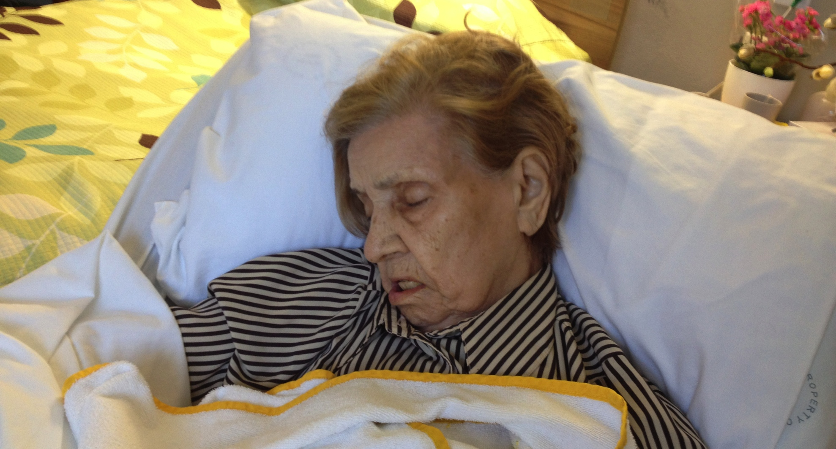
Figure 1-5: A patient in a hospice center

Slide 57
Challenges facing health care systems
Access to health care: services when needed
  Uninsured unable to access primary care (basic, routine, continual)
  Working poor: people have jobs, but no group coverage from employer

Slide 58
Access to health care
  Accessibility – locations of patients, providers
  Acceptability – attitudes of patients, providers
  Accommodation – resources in relation to services and patients’ ability to access them
  Affordability – patients’ abilities to pay
  Availability – patient needs vs. service capacity

Slide 59
Access to health care
Other factors:
  Effective access to outcomes – immunization, prevention, care quality
  Equitable or inequitable access – based on needs
  Potential access – provider availability, options, insurance coverage, transportation
  Realized access – type, size, purpose of services

Slide 60
Habits and social conditions
Smoking: leading cause of preventable disease and death (yet only 19% of population smokes)
Being overweight or obese (68.5% of population)
Excessive alcohol use (51.8%)
Hypertension (31.9%)
High serum cholesterol (13.6%)
Marijuana use (6.9%)
Cocaine use (2.6%)

Slide 61
Habits and social conditions
Poverty level = need more care, can’t pay
Preventive care = they may not need ER treatments that cannot be reimbursed
Health education, changing harmful habits vital to reducing costs

Slide 62
Habits and social conditions
Other factors:
  Immigration
  Breakdown of families, single mothers
  Domestic violence, abuse
  Living alone
  Homelessness
  Substance abuse

Slide 63
Maintaining the quality of care
How often desired outcomes occur, following the latest knowledge
Quality performance: health care delivery services, not individual behaviors

Slide 64
Health issues and the public
Programs utilize teaching and education via:
  Epidemiologists
  Hygienists
  Food and drug inspectors
  Toxicologists
  Other professionals

Slide 65
Health issues and the public
Global pandemics:
  Influenza H1N1 (swine flu) – 151,700 to 575,400 deaths
  Influenza H5N1 (bird flu) – 400 deaths
  Ebola virus – 5,200 deaths

Slide 66
Health issues and the public
Other significant conditions:
  HIV/AIDS
  Influenza H7N9
  Severe Acute Respiratory Syndrome (SARS)
  Middle East Respiratory Syndrome-Coronavirus (MERS-CoV)
  High infant mortality rates in U.S.
  Global antibiotic resistance

Slide 67
Individual responsibility for health
Health conditions often linked to poor lifestyle
Six of the 10 leading factors for disease are lifestyle related:
  Hypertension
  Unsafe sex
  Alcohol
  Tobacco
  High cholesterol
  Obesity

Slide 68
Preventive medicine
Focuses on health of individuals, communities, and defined populations
Protects, promotes, maintains health
Prevents disease, disability, death
  Primary level: factors that increase chance of contracting a disease
  Secondary level: factors combine; cause disease
  Tertiary level: signs and symptoms appear

Slide 69
Preventive medicine
Inadequacy has caused most costs being spent on treating diseases that are preventable
Lack of funding partly responsible for increase in:
  AIDS
  Tuberculosis
  Measles
  Premature births

Slide 70
Preventive medicine
Goals:
  Prevention of drug abuse, excessive alcohol use
  Becoming tobacco-free
  Healthy eating
  Avoiding injuries by violence-free living
  Mental and emotional health
  Reproductive and sexual health

Slide 71
Healthy People 2020
10-year national objectives to improve health:
  Being free of preventable disease, disability, injury, premature death
  Eliminating disparities
  Promoting good health for all
  Promoting quality of life, development, behaviors

