Slide 1
^{CHAPTER} 10
The Finance Plan:
How Much Money Do You Need?

Slide 2
Learning Outcomes
After studying this chapter, you should be able to:
Explain the importance and purpose of an accounting system.
Identify the importance of a balance sheet and an income statement and their three parts.
State the importance of a pro forma cash flow statement and its two parts.
Describe the role of a breakeven analysis in determining when the business actually makes a profit.
Identify the most common forms of taxation.
Explain the effect of taxes on the form of ownership.
Define the 36 key terms identified in this chapter.

Slide 3
Keeping Financial Records
To construct the necessary statements
To be able to compare budget figures (projected versus actual results) to see if you are on target
To satisfy the requirements of the Internal Revenue Service, keep records this long:
Record | Years | Record | Years
Sales | 3 | Payroll | 10
Inventory | 7 | Depreciation | Life of assets
Accounts Receivable | 3 | Equipment | Life of assets
Accounts Payable | 3 | Purchases | 3
Cash | 7

Slide 4
Importance of the
Accounting Function
Know if your business is making a profit
Compare your firm's current performance with past performance
Project future performance
Compare your firm's results with the results of other firms in your industry
Make informed decisions about what future actions your firm should take
A chart of accounts is invaluable in determining the above

Slide 5
Balance Sheet
Snapshot view of the financial value of the firm's assets, liabilities, and net worth at particular point in time
Divided into two sections: firm’s resources and the claims against them
Two types of claims against assets: claims of creditors and claims of owners
Assets
Liabilities
Net Worth (or owner’s equity)
It is called a balance sheet because the two sides always must balance.

Slide 6
Assets
Asset: something owned by the firm.
  Tangible assets that can be seen such as land, cash, equipment, and buildings.
  Intangible assets that cannot be seen such as patents or copyrights.
Current assets
Cash
Receivables
Inventory
Supplies
Prepaid expenses
Fixed assets
Land
Buildings
Equipment
Assets not used in production
Continued on next slides

Slide 7
Assets
Current assets: cash and other assets that can be converted to cash in generally less than one year
  Cash: bills, currency, coins, and checks on hand or in a checking or savings account
  Accounts receivable: money owed to company for sale of goods or services
  Net receivables: allowance for customer non-payment
  Merchandise inventory: amount of goods held for sale to customers at a particular moment
  Supplies: items the company holds that are used in supporting the production process, such as paper, pencils, lubricating oil, or light bulbs
  Prepaid: not yet been consumed

Slide 8
Fixed Assets
Fixed assets: land, buildings, equipment, and assets not consumed in the production of the firm's goods and services
  Usually last longer than one year
  Land is property used by the firm in its operations
  Buildings
  Depreciation: use of a fixed asset
  Accumulated depreciation: amount of a fixed asset's value that has been written off over time due to wear and tear
  Leasehold improvements: changes made to building or property to facilitate doing business

Slide 9
Liabilities: What You Owe
Current liabilities: obligations due in less than one year.
  Accounts payable: payments due to suppliers within 30 days from purchase
  Note or loans: due within the next 12-month period
  Other current liabilities, including expenses incurred but not paid such as taxes or wages
Long-term liabilities: obligations due after one year
  Notes payable or loans due after a year

Slide 10
Owner's Equity:
What You Are Worth
Net worth: accumulated net income of the company from its inception to the present
Net worth is not cash, does not represent a liquidation value and cannot be spent
It may even be a negative value if the amount a company owes is greater than its assets

Slide 11
The Income Statement
Sometimes called profit and loss statement
Shows revenues and expenses that result in profit or loss from operations during a given time

Slide 12
The Income Statement
Components:
  Revenues
    Income from selling product or service
  Cost of goods sold
    Cost of merchandise from all sources for resale, and is a cost to you
  Expenses
    Outflows or incurrence of liabilities as a result of producing goods or services
  Profits or loss
    This amount is added or subtracted from owner’s equity on balance sheet

Slide 13
Pro Forma
Cash Flow Statement
Pro forma statements are guidelines against which you can measure how your assumptions relate to reality
Methods of calculating pro forma cash flow statements
  Use present knowledge of business operation and its operating history to define necessary expense categories and any relationships that exist
  Use standard industry ratios

Slide 14
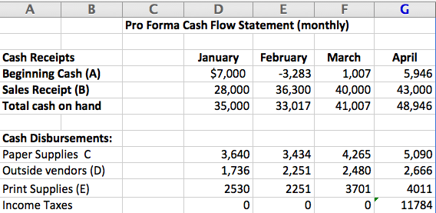
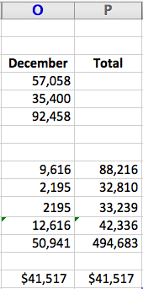

Pro Forma
Cash Flow Statement
Assumptions for Pro Forma Cash Flow Statements
The Excel spreadsheet below is Exhibit 10-6 Scrap Metal Recycler, Pro Forma Cash Flow Statement 2015. The sheet shows figures for all 12 months (but some columns and rows have been omitted here to conserve space)

Slide 15
Breakeven Analysis
Breakeven occurs when volume of sales is sufficient to cover all fixed and variable costs
The point at which revenues equal costs
Breakeven point also tells you the minimum level of sales you need to start or continue to operate
Components
  Revenue = unit sales X unit price
  Fixed costs are rent, loan payments, etc.
  Variable costs are direct labor, raw materials, and other costs that fluctuate with goods production

Slide 16
Taxation
Two sources of tax revenue: individuals and businesses
Taxes are payable on three levels: federal, state, and local
Taxes come in many different forms
Keep complete and detailed records

Slide 17
Common Business Taxes
Tax Burden
Income taxes
Social Security taxes
Unemploy-ment taxes
Sales taxes
Property taxes
Excise taxes

Slide 18
Tax Deductions
Cost of goods sold
Bad debts
Salaries and wages
Travel and entertainment
Rent / lease
Interest
Depreciation
Taxes
Automobile expenses
Miscellaneous expenses

Slide 19
Effects of Taxes on the
Form of Ownership
The owners of sole proprietorships, partnerships, S corporations, and limited liability companies (LLC) pay personal income taxes but no business taxes
S corporation and LLC allow you to bypass double taxation and thereby to minimize your tax bill

Slide 20
Key Terms
Accounts payable
Accounts receivable
Accumulative depreciation
Asset
Balance sheet
Breakeven analysis
Buildings
Cash
Chart of accounts
Cost of goods sold
Current assets
Current liabilities
Depreciation
Fixed asset list
Fixed assets
General ledger
Gross profits
Income statement
Income taxes
Intangible assets
Leasehold improvement
Liabilities
Long-term liabilities
Merchandise inventory
Net worth/owner's equity
Notes payable
Prepaid expenses
Pro forma statements
Profits (loss)
Property and excise taxes
Retained earnings
Sales taxes
Social security taxes
Supplies
Tangible assets
Unemployment taxes

