Slide 1
^{CHAPTER} 7
The Location and Layout Plan:
What Facilities Do You Need?
7–1

Slide 2
Learning Outcomes
After studying this chapter, you should be able to:
Describe the important factors to consider in making a location decision.
Examine the growth of home-based companies due to the popularity of the Internet.
List the important location decisions that manufacturing, retailing, wholesaling, and service firms must consider.
Identify factors affecting whether you build, buy, or lease facilities.
Examine the layout parameters for retail, wholesale, and service firms.
Utilize the Small Business Administration (SBA) and other sources for finding information on location and layout of a new entrepreneurial organization
Define the 10 key terms identified in this chapter.

Slide 3
Selecting a Location
Deserves very careful analysis
May be significant expenditure
Personal preferences
Home-based or online business
  Make sure you have a defined work space
  Check zoning requirements
  More popular with the development of Internet

Slide 4
General Location Factors
Shipping costs
Proximity to market
Transportation facilities
Labor supply
Suburban or rural
Community attitude
Cost of facilities
Taxes
Climatic conditions
Coordination
Site selection

Slide 5
Manufacturing Location
Transportation
Weight loss
  Process weight loss is the loss of raw materials that occurs naturally as an outcome of the manufacturing process.
Raw materials
Water power
Site selection

Slide 6
Retail Locations
City
  Size of the city's trading area
  Population and population trends in the trading area
  Total purchasing power and the distribution of purchasing power
  Total retail trade potential for different lines of trade
  Number, size, and quality of competition
  Progressiveness of competition

Slide 7
Retail Locations
Type of location
  Customer attraction power
  Quantitative and qualitative nature of competitive stores
  Availability of access routes to the stores
  Nature of zoning regulations
  Direction of the area expansion
  General appearance of the area
Type of business
Other considerations

Slide 8
Retail Choices
Downtown
Stand-alone structure
Small block of stores
Mall

Slide 9
Wholesale Locations
Derived demand: a market that springs up from people wanting goods for the use those goods have in completing a demanded product or process
Traditional wholesalers
Wholesale clubs
Manufacturing, retailing, and wholesaling coordination

Slide 10
Leasing Facilities
A lease is an agreement to rent an asset, which will be used as if it were owned.
Lessee is the party leasing the equipment, makes periodic payments.
Lessor is the party who owns the equipment being leased.
Leasing is big business now.

Slide 11
Advantages and Disadvantages of Leasing
Advantages
Disadvantages
  You get to use the asset
  Lease payments may be less than ownership
  Sometimes does not require a down payment
  Frees up other money for operating capital
  Equipment may be more up to date and better maintained
  You own nothing after the lease
  Costs more than ownership in the long run because of replacement costs
  Legal obligation not easily cancelled

Slide 12
Types of Leases
Operating lease: you use equipment in your business, while the title remains with the lessor
Leaseback: you buy an asset and sell it to another party and lease it back

Slide 13
Buying or Building Facilities
Two major considerations are important:
  Construction and design
  Function: appropriate room for material handling and office space.
Building must comply with zoning and ADA laws.

Slide 14
Facility Layout
Layout is the spatial arrangement of the physical facilities in the most efficient manner for the specific business.
Layout should fit your business.

Slide 15
Types of Layout
Product Layout
Start
Assembly
Assembly
Assembly
Finished product
Process or Function Layout
Department – men
Customer
Department - women
Department - children

Slide 16
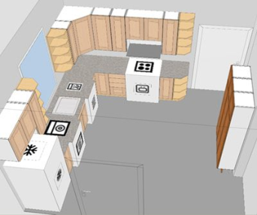
Types of Layouts
Cellular layout is commonly used in retail restaurant food preparation and repair services.
Fixed position layout is used in construction and services where job is done at customers’ business or home.
Product line layout: machinery and personnel arranged in sequential order production process takes in raw material at the beginning, works on it process by process, transferring it from station to station until it emerges as the finished product

Slide 17
Types of Layouts
Process or functional layout: all machines are grouped according to function
A
Bottling
C
Screw Cap Machines
Inputs
(grapes)
Outputs
(red or white wine)
B
Aging Casks
D
Corking Machines
PRODUCT
Red wine
White wine
PRODUCTION ROUTE
B – A – D
A - C

Slide 18
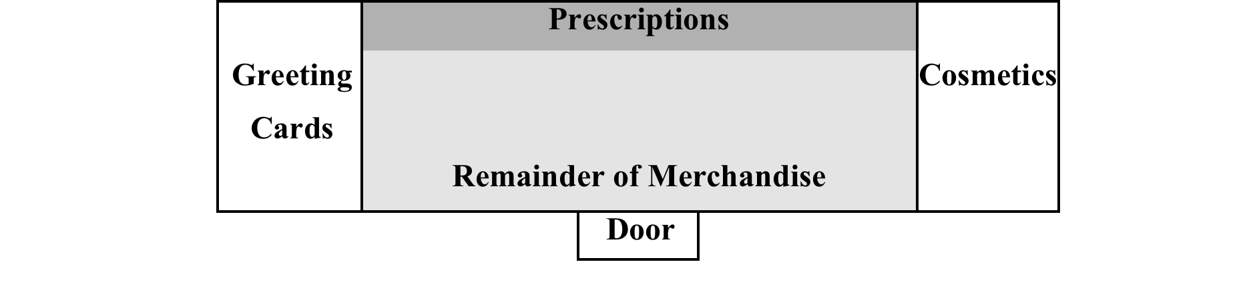
Retail Layout
Process layout makes it easy for customer to have access to goods.
Demand items are specific items that a customer needs to purchase.
Impulse items are items people want or buy on the spur of the moment.
Exhibit 7-6
Typical Drug Convenience Store Process Layout

Slide 19
Wholesale Warehouse Layout
A major difference between retailers and wholesalers is their total layout.
Wholesaler membership clubs have combined models of traditional retail with traditional wholesalers.
Faster moving items are closest to the shipping and receiving platform.

Slide 20
Service Layout
Two major considerations
  Does the customer come to your place of business? If so, it is common to use a process layout.
  Do you go to the customer to do the service? If so, it is common to use the fixed-position layout.

Slide 21
Sources of Information
Small Business Administration
U.S. Census Bureau
United States Department of Labor Bureau Statistics

Slide 22
Key Terms
demand items
derived demand
home-based business
layout
leaseback leases
lessee
lessor
operating lease
process weight loss
product line layout

