Slide 1
^{CHAPTER} 5
Business Planning:
What’s Your Legal Form and Strategy?

Slide 2
Learning Outcomes
After studying this chapter, you should be able to:
Explain what a business plan is and who will read it.
Describe the “5 Cs of Credit.”
List the main sections of a business plan.
Explain why the executive summary is written last but placed first in the business plan.
Describe what the introduction section of the business plan includes.
Discuss the differences among the legal structure of the sole proprietorship, partnership, corporation, and limited liability company (LLC).
Describe the strategy formulation section of the business plan process.
Identify the five internal environmental components and the two primary external environmental factors that affect organizational performance, and the difference between these two environments and their interrelationship.
Define the 19 key terms identified in this chapter.

Slide 3
Entrepreneurial Process Model
Selecting the New Venture | Planning the Venture | Financing and Controlling the Venture
Decision to be an entrepreneur or engage in entrepreneurial behavior
Develop an effective business plan
Get funding, start the venture, and run the business successfully
Select an option to become an entrepreneur
Develop a business model
Test the feasibility of your model
*Fails -- Stop
Pass -- Proceed
* You can go back to develop and test other business models

Slide 4
Entrepreneurial Process
Business model identifies product and service value, customers, the way it makes a profit, and operations
Business plan gives the details of the business model in a formal written document
Strategy is the process of optimizing the effectiveness of the business model configuration against the external environment

Slide 5
The Business Plan
States the objectives of the firm and the steps necessary to achieve them
Projects 3-5 years ahead and outlines the route a company intends to take
The business plan answers three questions:
  Where am I now?
  Where am I going?
  How will I get there?

Slide 6
Resources to Help You Develop Your Business Plan
Valuable Resources
Business Plan Pro
Small Business Administration
SCORE
Small Business Development Center

Slide 7
The “5 Cs of Credit”
Character
Capacity
Capital
Conditions
Collateral

Slide 8
Sections of the Business Plan
Executive summary
Production/operation
Introduction
Human resources
Strategy formulation
Financing function
The marketing function
Controls
Location and layout
Appendix

Slide 9
The Executive Summary
Written last because you have to write a business plan before you can summarize the main points of the plan
Should include at least the following:
  A brief explanation of the product or service that the business will provide and why this product or service will satisfy customer needs (competitive advantage)
  A brief summary of the key people (management team) starting the business
  The potential profitability
  The possible expansion of the business in the future

Slide 10
Introduction Section
Background of the business
Management and organization
Form of ownership
  Whether proprietorship, partnership, or corporation
  How profits will be distributed
  Any salaries of key managers

Slide 11
Legal Form of Ownership
Three elements to consider: number of owners, what kind of taxation, and what kind of liability
Sole Proprietorship
  Owned and operated by one person
  Business name not required
  Unlimited liability
  Only pays personal income taxes on profits

Slide 12
Exhibit 5-3
Sample Organizational Chart for Sole Proprietorship
President/Owner/ Proprietorships
Human Resources
Accounting & Finance
Production
Sales

Slide 13
Exhibit 5-4
Advantages and Disadvantages of Sole Proprietorships
Advantages
Ease of startup
Free to take profits
Disadvantages
Unlimited liability
Maintaining the overall direction of your business
Freedom to manage as you choose
Few legal restrictions
Taxes
Demise of the firm

Slide 14
Partnerships
An association of two or more co-owners of a business
Many professional firms are partnerships

Slide 15
Organizational Chart for Partnership
Co-Owner
Co-Owner
Human Resources
Accounting & Finance
Production
Sales

Slide 16
Exhibit 5-5
Advantages and Disadvantages of Partnerships
Advantages
Ease of startup
Free to take profits as one of the owners
Disadvantages
Unlimited liability from general partners
As business grows, it gets hard for original partners to manage
Freedom to manage as you and your partner choose
Few legal restrictions
Taxes
Demise of the firm
Possible difficulty in raising capital
Transfer of interest

Slide 17
Elements of Partnerships
Types of partnerships
  General partnership
  Limited partnership
  Unlimited partnership
The partnership agreement
The Uniform Partnership Act

Slide 18
Corporations: Defined
A corporation is a legal entity owned by an unlimited number of shareholders that have limited liability under a common name that pays either single or double taxes.
There are also nonprofit corporations that have no individual owners and pay no taxes.

Slide 19
Organizational Chart for Corporations
Board of Directors
President
Production
Marketing
Salespeople
Operations
Accounting & Finance
Human Resources

Slide 20
Exhibit 5-8
Advantages and Disadvantages of Corporations
Advantages
Limited liability
Less personal guarantees
Disadvantages
Cost, time, paperwork
Perpetuity
Funding sources
Transfer of ownership
Expanded pool of talent
Expansion and contraction
Limited liability does NOT apply to taxes
Perils of increasing capitalization
Federal and state control
Double taxation

Slide 21
Taxation of the C and Nonprofit Corporations
The C corporation pays business taxes on profits, and its unlimited number of shareholders with limited liability pay individual taxes on any share of the distribution of profits (double taxation).
Nonprofit corporations pay no taxes on profits, and because there are no owners, profits are not distributed.

Slide 22
Taxation of the S Corporation
The S corporation does not pay business taxes; its unlimited number of shareholders with limited liability have their profit distributions taxed as individual income taxes.
To qualify as an S corporation,
  Shareholders must be U.S. citizens
  The S corporation can’t be a subsidiary
  Partnerships and C corporations can’t own shares
  Certain types of trusts and estates can own shares
  The S can only have one class of stock, common or preferred
  It can’t have more than 100 members, and all members must agree to be formed as an S corporation

Slide 23
Strategy Formulation of the Business Plan
Mission: the organization’s purpose or reason for being
Objectives (prioritized): what the organization wants to accomplish
Environmental Analysis: includes an analysis of the internal environment, including the mission and objectives, and its external environment
A strategy is a plan for achieving the organization’s mission and objectives.

Slide 24
Internal Environment Factors
The internal environment includes the management, mission and objectives, resources, the transformation process, and structure that affect the firm's performance from within its boundaries
Management
Mission and Objectives
Resources
Transformation Process
Structure
Exhibit 5-10
Internal Environment Factors

Slide 25
Mission Statement
Reveals an organization’s purpose or reason for being
Includes present and future products and services to be offered
Includes your industry and target market
Competitive advantage is identified based on the environmental analysis
Philosophy of the business

Slide 26
The Transformation Process
The transformation process is the system for converting inputs into outputs. It has a direct effect on the productivity and substitutability of the firm.
Inputs
Transformation Process
Output
Feedback
Exhibit 5-12
The Transformation Process

Slide 27
Structure
An organization is a system. A system is a set of interacting elements in which each part affects the whole, and each part is affected by at least one other part.
END: Mission, Objectives Stating End
Exhibit 5-13
Means and Ends
MEAN: Management
MEAN: Resources
MEAN: Transformation Process
MEAN: Structure

Slide 28
External Environment Analysis
External environment includes the factors that affect the business's performance from outside its boundaries.
Task factors
Customers
Competitors
General factors
Society
Technology
Economy
Government
Suppliers
Labor force
Shareholders

Slide 29
SWOT Analysis
A firm identifies its Strengths, Weaknesses, Opportunities, and Threats
How does your business compare to the competition?
What does it take to be successful?
What opportunities and threats do you foresee?

Slide 30
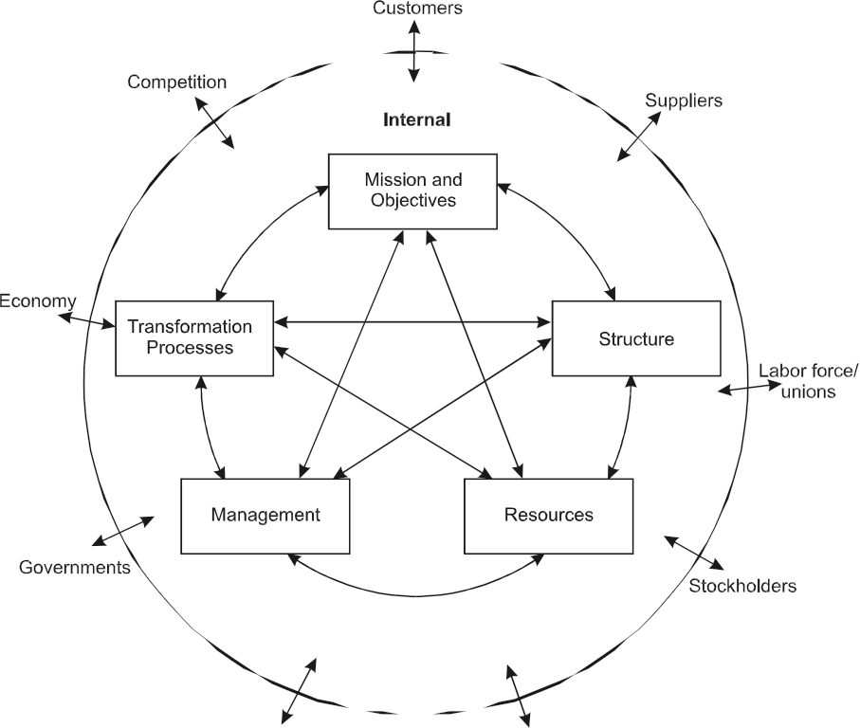
Exhibit 5-15 The Organizational Environment
↔ Feedback, influence, control

Slide 31
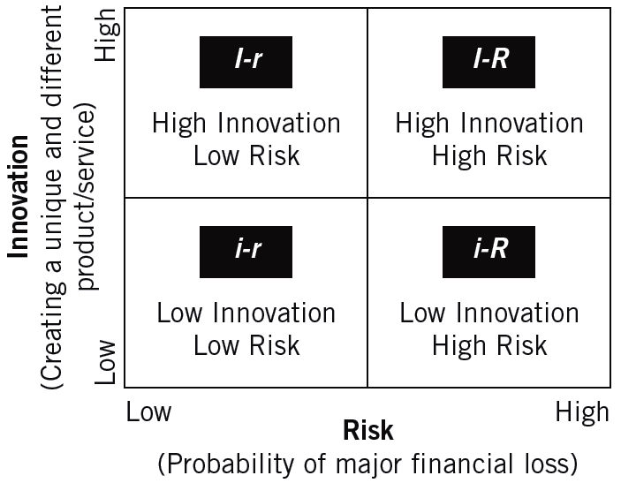
Exhibit 5-16
The Entrepreneurial Strategy Matrix

Slide 32
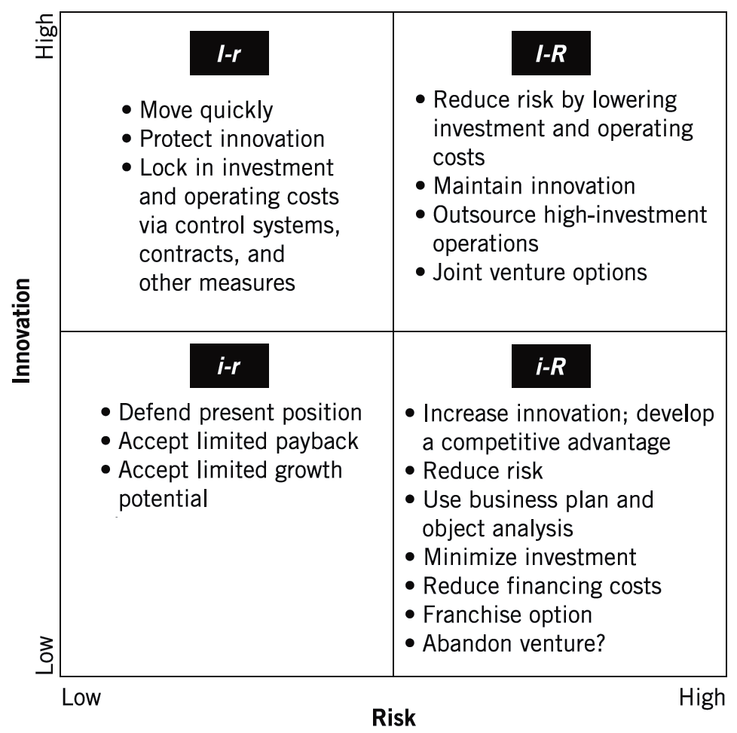
Exhibit 5-16
The Entrepreneurial Strategy Matrix

Slide 33
Key Terms
Business plan
C Corporation
Corporation
External environment
General partners
Internal environment
Limited liability company (LLC)
Limited partner
Partnership
Partnership agreement
Unlimited partnership
S Corporation
Sole proprietorship
Stakeholders
Strategy
System
Transformation process
Uniform Partnership Act (UPA)
Unlimited liability
5–33

