Slide 1
7. Medical Ethics 1 – Abortion and the Right to a Child

Slide 2
What is abortion?
Abortion is the induced termination of a pregnancy to destroy the foetus. In the UK, abortion is legal up to the 24th week of the pregnancy.
After that time an abortion can be carried out if there is a serious threat to the life of the mother or the foetus is severely disabled.
According to the current law, at present a woman must have the agreement of two doctors for the termination.

Slide 3
When does life begin? – The value of potential and real life
At conception
Casti Connubi (1869) the foetus is a human person from the moment of conception and the life of an unborn child is as sacred as that of its mother
Humanae Vitae (1968)
Catechism of the Catholic Church (1994)
For it was you who formed my inward parts; you knit me together in my mother’s womb. (Psalm 139:13).

Slide 4
When does life begin? – The value of potential and real life
After conception
According to the Human Fertilisation and Embryology Act of 1990, the foetus is given legal protection from 24 weeks if it is possible for it to survive outside the womb.
This is the legal point of viability: however, to take this time as the moment life begins is problematic, as modern technical advances mean that the foetus can survive outside the womb before this time.

Slide 5
When does life begin? – The value of potential and real life
At birth
For centuries it was established that birth was the point at which life began and the deliberate killing of a baby after birth was regarded as murder.
Mary Anne Warren argues that birth is the time when the baby no longer relies totally on the mother for its survival.
Jonathan Glover rejects this, as there are no major differences between a late foetus and a newborn or premature baby.

Slide 6
Christian teaching on human nature and the human condition
Christians see human nature as being in the ‘image of God’ because it has reason and free will and is able to be its own master.
Modern theologians accept that the stories of the creation of a perfect world and the Fall are mythical, and evolution suggests that the world is changing and becoming more diverse.
Humanity should concentrate not on a past fall from grace but on becoming more ethical beings and so making the world better.

Slide 7
Life of the mother vs. life of the child
It is now very rare that a choice has to be made between the life of the foetus and the life of the mother.
Many would say that saving the life of the mother is not abortion and would use the doctrine of double effect to argue this.
The right to life of the foetus has recently been argued for in the case of late abortions.

Slide 8
Religious approaches to the sanctity of life
The teaching on the sanctity of Life holds that all life is sacred, worthy of respect and reverence, and intrinsically worthwhile.
People therefore have a duty to preserve life.

Slide 9
Strong sanctity of life argument
God is the giver and creator of life and people have no right to destroy what he has given.
People are seen as created in the ‘image of God’ – imago dei – so humans are set apart from other animals and have a ‘spark’ of divinity within them.
The breath of life was breathed by God into Adam.

Slide 10
Strong sanctity of life argument
If God is the creator of life it is down to him to say when it should start and end.
A person does not have the freedom to decide to end his or her own or anyone else’s life.
He said, ‘Naked I came from my mother’s womb, and naked shall I return there; the Lord gave, and the Lord has taken away; blessed be the name of the Lord.’ (Job 1:21)
‘You shall not murder.’ (Exodus 20:13)

Slide 11
Strong sanctity of life argument
This idea of the sanctity of life is also part of the teaching of Natural Law which underlies the ethical teaching of the Catholic Church.
Taking life is seen as intrinsically evil, and unborn life must be protected.
Natural Law states that preserving the innocent is a primary precept and there are no exceptions which make it right.

Slide 12
Strong sanctity of life argument
In some cases, abortion may be justified using the doctrine of double effect.
For example, in the event of an ectopic pregnancy (where the embryo has not implanted in the womb but is developing in the fallopian tubes) it is considered all right to remove the embryo, as the intention is to save the life of the mother rather than to kill the foetus.
The death of the foetus is simply an unfortunate side-effect.
This teaching does not mean that the abortion can be seen as the lesser of the two evils.

Slide 13
Weak sanctity of life argument
The Church of England’s report of 1965, Abortion: An Ethical Discussion, expresses overriding compassion for the needs of the mother, especially where there is a threat to her mental or physical health.
This view was reinforced in a more recent document, Abortion and the Church, in 1993:
‘We do not believe that the right to life, as a right pertaining to persons, admits of no exceptions whatever; but the right of the innocent to life admits surely of few exceptions indeed.’

Slide 14
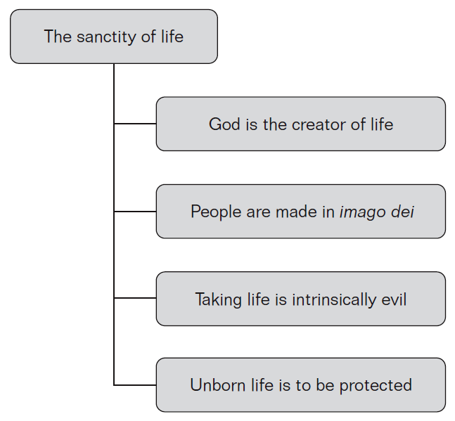
Sanctity of life

Slide 15
Strengths of the sanctity of life argument
It values all human life equally, regardless of status or gender.
It states clearly that killing is always wrong and respects the individual’s future.
It gives everyone equal dignity.
It avoids too much group pressure and power (e.g. to abort a disabled foetus).

Slide 16
Weaknesses of the sanctity of life argument
Charles Darwin challenged the biblical view of imago dei with his theory of natural selection.
Kant saw no reason to link vital signs to valuing life – but he did link the possession of reason to valuing life.
Peter Singer stated that to treat human life as having a special priority over animal life is ‘speciesism’. So we ought to value all life and not just human foetuses.
The sanctity of life view cannot cope with conflicts of duty – which life is more sacred: that of the mother or that of the foetus?

Slide 17
Quality of life
Some scholars think that those who hold a sanctity of life position as regards abortion make it work only by including quality of life arguments.
The quality of life view allows the value of life to vary with its quality and may factor in the immanence of death, constancy of pain, an ability to think, an ability to enjoy life and make rational choices.
However, when considering the foetus there is always the question of who benefits and whose quality of life is being judged: that of the foetus, the parents or society as a whole?

Slide 18
Is the foetus a person? Does the foetus have a right to life?
A person has to be conceived by humans.
A person has to have a human genetic structure.
A person has to look like a human.
A person has a soul.
A person is viable – it can survive birth.
A person has a future like ours.

Slide 19
Is the foetus a person? Does the foetus have a right to life?
Mary Anne Warren suggests the following criteria:
sentience – the ability to have conscious experiences
emotionality – the ability to feel happy, sad, loving
reason – the ability to solve new and complex problems
the capacity to communicate
self-awareness – awareness of oneself as an individual and as a member of a social group
moral agency – the ability to regulate one’s actions through moral principles.

Slide 20
Religious approaches for and against abortion
The religious approaches to abortion all hinge on the idea of the sanctity of life, and the idea of ensoulment.
Definitions of when the soul enters the body have changed over time.
Thomas Aquinas, following Aristotle, believed that male foetuses became ‘animated’ or acquired a soul only 40 days after conception, whereas females were believed to take longer to develop, with ensoulment taking place after 90 days.

Slide 21
Religious approaches for and against abortion
The Catholic Church now says that human life begins when the woman’s egg is fertilised by the male sperm – or rather it says that, as it is not certain when life begins, it is safer to say it is at fertilisation.
‘I declare that direct abortion, that is abortion willed as an end or as a means, always constitutes a grave moral disorder, since it is the deliberate killing of an innocent human being.’
(Evangelium Vitae 62)

Slide 22
Ethical issues in legislation about abortion
Many argue for women’s right to choose what to do with their own bodies and that the right to abortion is vital for women to achieve their potential as far as employment, education prospects, incomes and opportunities are concerned.
Some would argue that denying abortion is a barrier to full social, economic and political equality for women. This approach points out that women are also people, not just a container for the foetus.

Slide 23
Ethical issues in legislation about abortion
‘A pregnancy to a woman is perhaps one of the most determinative aspects of her life. It disrupts her body. It disrupts her education. It disrupts her employment. And it often disrupts her entire family . . . This . . . is a matter which is of such fundamental and basic concern to the woman involved that she should be allowed to make the choice as to whether to continue or terminate her pregnancy.
(C.M. Condit, Decoding Abortion Rhetoric pp. 99f)

Slide 24
Does the definition of human life stop abortion being murder?
The foetus depends solely on the mother for its existence. This is different from the new born baby who depends on society – on other people – to feed it, clothe it and love it.
The foetus then is not an independent person so killing it is not murder.
However, one could argue that killing a child before it reaches consciousness is not murder – a newborn baby, even one that is premature and in an incubator, still survives independently of the mother’s body.

Slide 25
Can abortion ever be said to be good?
Deontological ethics would say that an action is always right or wrong.
Natural Law would say that the abortion is never good as it goes against the primary precept to preserve the innocent and stops procreation.
Kantian ethics also has difficulties when answering the question of whether abortion can ever be considered good: when the categorical imperative is applied to abortion there are immediate difficulties. Abortion would be hard to universalise.

Slide 26
Can abortion ever be said to be good?
Teleological ethical theories may consider abortion to be good in some situations.
Utilitarianism does not accept the principle that human life has absolute value and that this should be upheld whatever the consequences, but attempts to assess each individual situation on its own merits to promote the greatest happiness for those concerned.

Slide 27
Do humans have a right to life?
A potential person must always be given full human rights unless its existence interferes with the right to life, freedom and the pursuit of happiness of an existing and conscious human being.
On the other hand many people will consider viability as the moment from which a foetus has the right to life, and this seems to be a gradual process depending on your viewpoint and beliefs about personhood.

Slide 28
Abortion
Ultimately what determines our attitude to abortion is the value we place on the foetus and whether we consider it to be a human being from conception.
All these issues arising from abortion feed into each other and one cannot be considered without considering the others.

