Slide 1
5. Utilitarianism

Slide 2
What is Utilitarianism?
You have probably heard someone justify their actions as being for the greater good. Utilitarianism is the ethical theory behind such justifications.
Utilitarianism is a teleological theory of ethics. Teleological theories of ethics look at the consequences – the results of an action – to decide whether it is right or wrong.
Utilitarianism is a consequentialist theory.

Slide 3
Hedonism
The idea that ‘good’ is defined in terms of pleasure and happiness makes utilitarianism a hedonistic theory.
The Greek philosophers who thought along similar lines introduced the term eudaimonia, which is probably best translated as the harmonious well-being of life.

Slide 4
Jeremy Bentham
Jeremy Bentham developed his ethical system around the idea of pleasure and it is based on ancient hedonism, which pursued physical pleasure and avoided physical pain.
According to Bentham, the most moral acts are those that maximise pleasure and minimise pain. This has sometimes been called the ‘utilitarian calculus’. An act would be moral if it brings the greatest amount of pleasure and the least amount of pain.

Slide 5
Pain vs. pleasure
Bentham said:
‘The principle of utility aims to promote happiness which is the supreme ethical value. Nature has placed us under the governance of two sovereign masters, pain and pleasure. An act is right if it delivers more pleasure than pain and wrong if it brings about more pain than pleasure.’

Slide 6
Hedonic Calculus
the intensity of the pleasure (how deep)
the duration of the pleasure caused (how long)
the certainty of the pleasure (how certain or uncertain)
the remoteness of the pleasure (how near or far)
the chance of a succession of pleasures (how continuous)
the purity of the pleasure (how secure)
the extent of the pleasure (how universal)

Slide 7
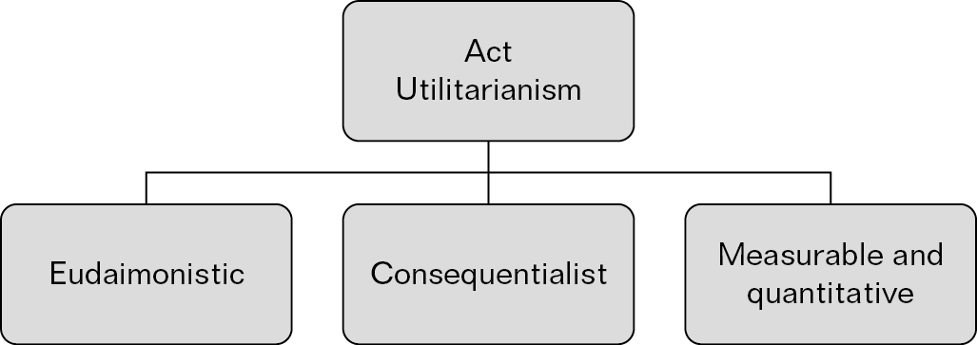
Act Utilitarianism

Slide 8
John Stuart Mill
The Greatest Happiness Principle
‘The Greatest Happiness Principle holds that actions are right in proportion as they tend to promote happiness, wrong as they tend to produce the reverse of happiness. By happiness is intended pleasure, and the absence of pain; by unhappiness, pain and the privation of pleasure.’

Slide 9
John Stuart Mill
Mill modifies Bentham’s approach, especially the quantitative emphasis.
‘Some kinds of pleasures are more desirable and more valuable than others, it would be absurd that while, in estimating all other things, quality is not also considered as well as quantity.’

Slide 10
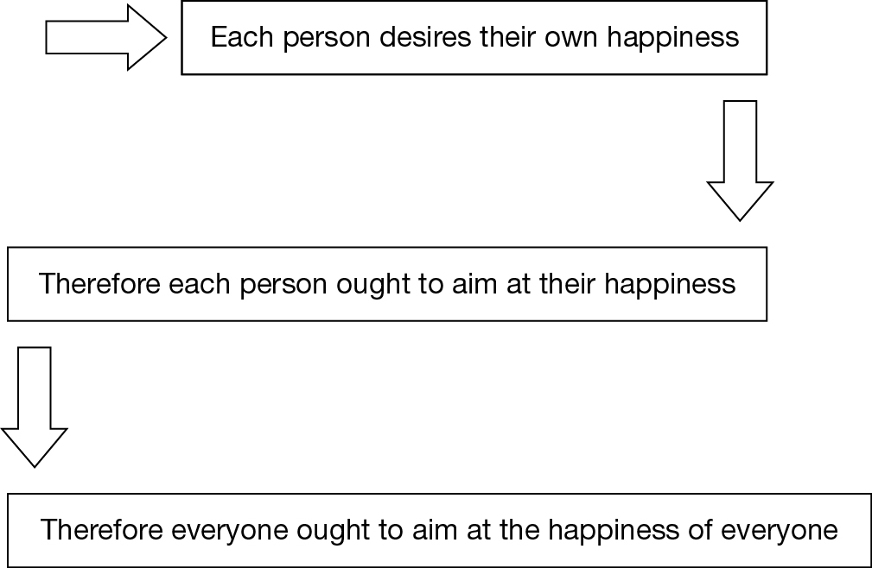
Universalisibility

Slide 11
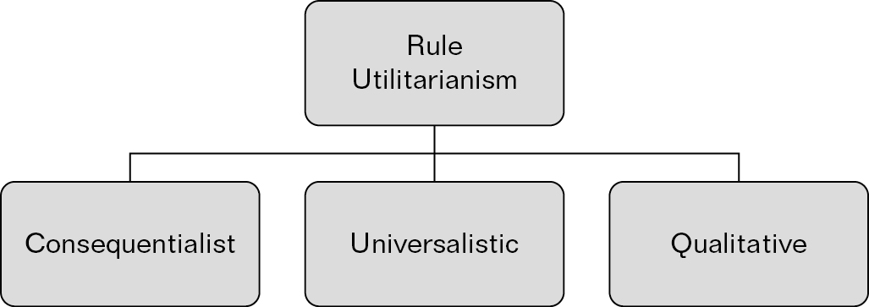
Rule Utilitarianism

Slide 12
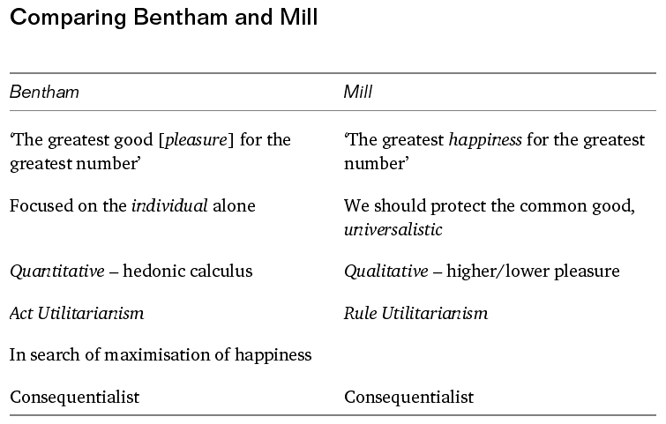
Bentham and Mill

Slide 13
Henry Sidgwick
In The Methods of Ethics Sidgwick argues that the balance of pleasure over pain is the ultimate goal of ethical decisions.
His argument is closer to Bentham than to Mill, as he questions how it is possible to distinguish between higher- and lower-order pleasures, and how we can distinguish one higher-order pleasure from another.
However, Sidgwick does argue that the process of deciding is intuitive – we make self-evident judgements about what we ought to do.

Slide 14
Preference Utilitarianism
Preference Utilitarianism is a more recent form of Utilitarianism and is associated with R.M. Hare, Peter Singer and Richard Brandt.
An Act Utilitarian judges right or wrong according to the maximising of pleasure and minimising of pain; a Rule Utilitarian judges right or wrong according to the keeping of rules derived from utility.
A Preference Utilitarian judges moral actions according to whether they fit in with the preferences of the individuals involved.

Slide 15
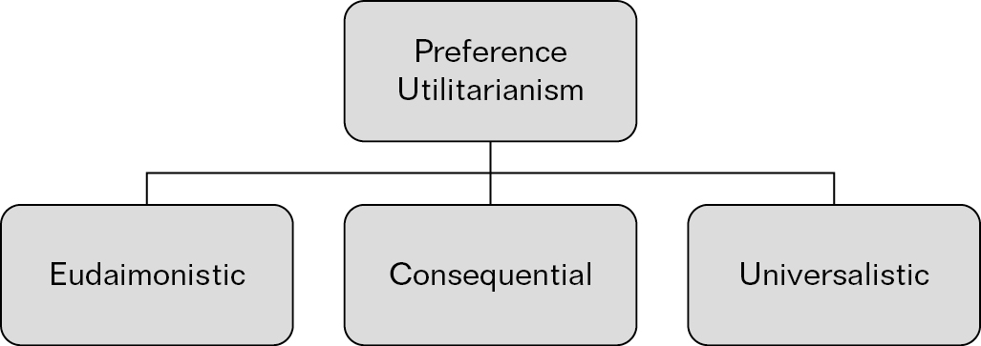
Preference Utilitarianism

Slide 16
Peter Singer
He says that ‘our own preferences cannot count any more than the preferences of others’.
For Singer, the ‘best possible consequences’ means what is in the best interests of the individuals concerned – this is different from Bentham, Mill and Sidgwick, as he is not considering what increases pleasure and diminishes pain.

Slide 17
Richard Brandt
In his book A Theory of the Good and the Right (1979), he talks about the preferences you would have if you had gone through a process of cognitive psychotherapy and explored all the reasons for your preferences and rejected any you felt were not true to your real values.
He argued that the morality you would then accept would be a form of Utilitarianism.

Slide 18
Karl Popper
Karl Popper coined the term Negative Utilitarianism and argues that we should aim to minimise suffering rather than maximise pleasure.
He considered that the principle of utility and the search for the happiness of the majority could easily lead to benevolent dictatorship.
He thought that the increase in happiness should be left to private initiative and public policy should aim to minimise suffering.

Slide 19
Utilitarianism and religious ethics
Utilitarianism has a teleological approach to ethics, focusing on the outcome of actions.
Christian ethics seems more deontological as shown in the absolutes of the Ten Commandments.

