Slide 1
3. Natural Moral Law

Slide 2
What is Natural Moral Law?
Natural Moral Law is not just about ‘doing what comes naturally’ – it is not about what nature does in the sense of being observed in nature.
Natural Moral Law is based on nature interpreted by people – reason.
Natural Moral Law is not exactly a law in that it does not give you a fixed law – it is not always straightforward and there is some flexibility in its application.

Slide 3
The origins of Natural Moral Law
The earliest theory of Natural Moral Law first appeared among the Stoics, who believed that God is everywhere and in everyone.
Humans have within them a divine spark which helps them find out how to live according to the will of God, or in other words to live according to nature.
Humans have a choice whether to obey the laws that govern the universe but they need to use their reason to understand and decide whether to obey these cosmic laws.

Slide 4
The origins of Natural Moral Law
Thomas Aquinas linked this idea of a cosmic Natural Moral Law with Aristotle’s view that people, like every other natural object, have a specific nature, purpose and function.
Aristotle considered that, not only does everything have a purpose but that its supreme good is found when it fulfils that purpose (e.g. the knife cuts sharply).
His idea of purpose leads to his idea of what is good.

Slide 5
The origins of Natural Moral Law
The supreme good for humans is eudaimonia, which is usually translated as happiness but includes the idea of living well, thriving and flourishing with others in society.
Aristotle saw this as the final goal for humans, but this is to be achieved by living a life of reason.

Slide 6
The origins of Natural Moral Law
Understanding Aristotle’s theory of causality is vital for understanding his approach to ethics: there are four causes that lead to a thing being the way it is:
Material cause
Formal cause
Efficient cause
Final cause

Slide 7
The Natural Moral Law of Thomas Aquinas
Aquinas used the ideas of Aristotle and the Stoics as an underpinning for Natural Moral Law:
Human beings have an essential rational nature given by God in order for us to live and flourish
Even without knowledge of God, reason can discover the laws that lead to human flourishing
The Natural Moral Laws are universal and unchangeable and should be used to judge the laws of particular societies

Slide 8
The purpose of human beings
Like Aristotle, Aquinas concludes that humans aim for some goal or purpose – but he does not see this as eudaimonia.
Humans, for Aquinas, are all made ‘in the image of God’ and so the supreme good must be the development of this image – perfection.
Unlike Aristotle, Aquinas did not think that this perfection, or perfect happiness, was possible in this life.
Aquinas sees happiness as beginning now and continuing in the next life.

Slide 9
The purpose of human beings
In his book Summa Theologiae, Aquinas attempts to work out what this perfection actually is by examining the ‘reflections’ of Natural Moral Law as revealed by:
Eternal Law
Divine Law
Natural Moral Law.

Slide 10
Natural inclinations
Aquinas thought that God had instilled in all humans inclinations to behave in certain ways which lead us to the highest good and, by using our reason, we can discover the precepts (laws) which express God’s Natural Moral Law built into us.
The most fundamental inclination, according to Aquinas, is to act in such a way as to achieve good and avoid evil. He thought this because we are designed for one purpose – perfection – and so we would not knowingly pursue evil.

Slide 11
Primary precepts
The primary precepts are as follows:
the preservation of life
reproduction
the nurture and education of the young
living peacefully in society
to worship God.
These primary precepts are always true in that they point us in the right direction and are necessary for human flourishing.

Slide 12
Secondary precepts
The secondary precepts, on the other hand, are dependent on our own judgements of what actually to do in a given situation; this makes them more teleological than deontological.
The secondary precepts require experience, the use of reason and the exercise of wisdom.

Slide 13
The doctrine of double effect
There are times when we have moral dilemmas in which we cannot do good without a bad consequence.
To solve this dilemma the doctrine of double effect was devised, roughly saying that it is always wrong to do a bad act intentionally in order to bring about good consequences, but that it is sometimes all right to do a good act despite knowing that it will bring about bad consequences.

Slide 14
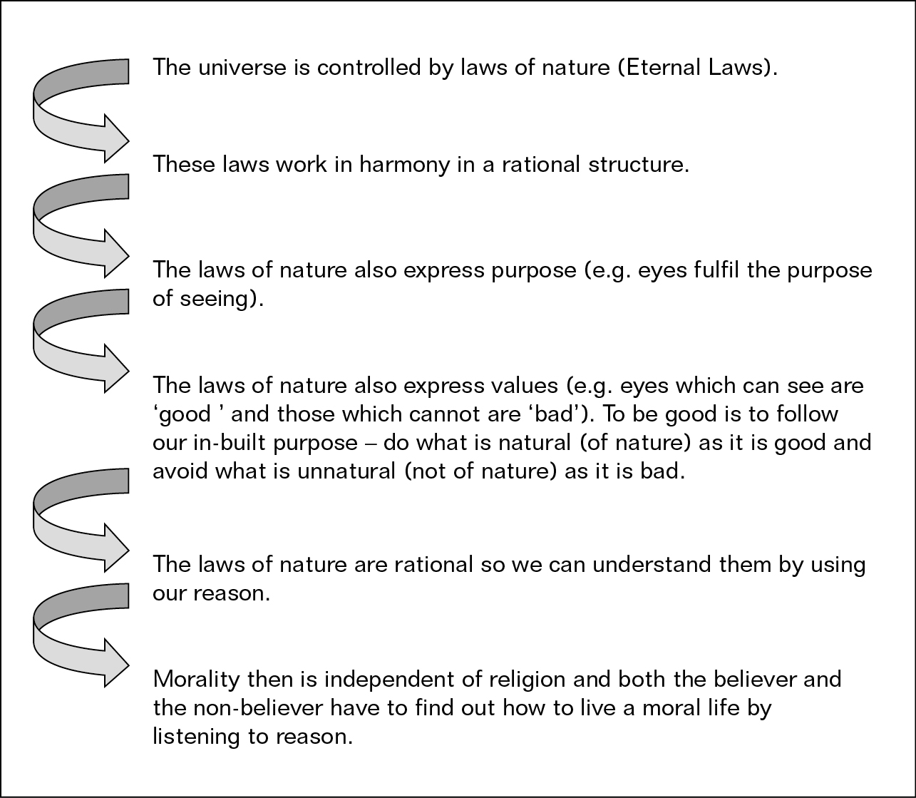
Summary of Natural Moral Law

Slide 15
Strengths of Natural Moral Law
It allows for a clear-cut approach to morality and establishes common rules.
The basic principles of preserving human life, reproduction, learning and living in society are common in all cultures and so Natural Moral Law is reasonable.
Natural Moral Law does not simply dictate what should be done in individual cases from general moral principles.

Slide 16
Strengths of Natural Moral Law
Natural Moral Law concentrates on human character and its potential for goodness and flourishing rather than on the rightness or wrongness of particular acts, and so it allows for some measure of flexibility.
Moral decision making is not done by reason alone.

Slide 17
Weaknesses of Natural Moral Law
Natural Moral Law finds it difficult to relate complex decisions to basic principles in practice.
Natural Moral Law depends on defining what is good, but according to G.E. Moore this commits the naturalistic fallacy.
Others argue that Natural Moral Law is based on assumptions about the world and the inbuilt purpose of things that are questioned by modern science.

Slide 18
Weaknesses of Natural Moral Law
Darwin shows that nature has particular characteristics due to natural selection. There is no divine purpose – it is simply the way things are.
Kai Neilsen argues against Aquinas’ belief in a single human nature common to all societies.

Slide 19
Weaknesses of Natural Moral Law
Karl Barth thought that Natural Moral Law relies too much on reason and not enough on the grace of God and revelation in the Bible.
Some Catholic scholars also distrust philosophical theories such as Natural Moral Law, and insist it must be supplemented by revelation or by Church teaching – this has led to some rigid interpretations of Natural Moral Law.

Slide 20
John Finnis
John Finnis approaches Natural Moral Law in the same way as Aquinas – as a type of moral theory not a type of legal theory, but with one difference: without the need for God.
He defines Natural Moral Law as requiring ‘a set of basic practical principles which indicate the basic forms of human flourishing as goods to be pursued and realised, and which are in one way or another used by everyone who considers what to do, however unsound his conclusions’.

Slide 21
John Finnis: Seven basic goods
Life
Knowledge
Play
Aesthetic experience
Sociability
Practical reasonableness
Religion

