Slide 1
15. Environmental and Business Ethics

Slide 2
What is environmental ethics?
Environmental ethics considers the ethical relationship between people and the natural world and the kind of decisions people have to make about the environment:
Should we continue to cut down the rainforests for the sake of human consumption?
Should we continue to manufacture petrol-driven cars when we have the technology to make cars that do not pollute the environment?

Slide 3
What is environmental ethics?
Should we knowingly cause the extinction of other species?
What are our environmental obligations to future generations?
Should humans be forced to live a simpler lifestyle in order to protect and preserve the environment?

Slide 4
Threats to the environment
Climate Change
Animal Rights
Andrew Linzey was the first Professor of Ethics, Theology and Animal Welfare at Oxford, and writes extensively against animal cruelty, hunting, fur farming and animal experimentation. Linzey considers that God’s love for creation is inclusive of animals, and so he advocates vegetarianism as most meat is the product of intensive farming, and that ‘we should live more simply so that others may simply live’ (Ghandi).

Slide 5
Threats to the environment
This view is endorsed also by Peter Singer, but for different reasons. He used a set of criteria for moral status based on sentience.
This means that moral worth includes animals – if not, we are guilty of ‘specieism’.
Our treatment of all humans and animals should be equal.

Slide 6
Threats to the environment
Criticism of Animal Rights
Kant denies that domestic animals are to be treated only as tools and insists that there are moral limits on how we should use them.
Animals should not be worn out and overworked, nor should they be cast aside once they are too old.
Kant thinks it is all right to kill animals for food, but killing for sport he sees as morally wrong.
Kant also thinks that we have moral duties regarding the natural world and must not destroy it.

Slide 7
Threats to the environment
Criticism of Animal Rights
Roger Scruton in Animal Rights and Wrongs (1996) used an argument based on Kant’s approach which restricts animal rights to animals that are kept by humans, but says that we do not have a duty of care to wild animals.
He considers that wild animals have no greater standing than wild plants.

Slide 8
Conservation of the living environment
Should moral standing be extended to all living things including the plants and trees that are so essential for our survival?
Singer argues that, because plants are non-sentient, there is a problem in trying to determine their interests in staying alive.
Or should moral standing be extended to the whole Earth? The rocks, mountains seas, rivers and the ecosystems – in short the entire natural world?
Singer would not agree and admits that, although the argument for the preservation of the environment may be strong, it is difficult to argue for its intrinsic value.

Slide 9
The developing world and attempts to restrict development
The most important question here is whether developing countries should be restricted in their development if this development is environmentally damaging.
Population growth in developing countries is unsustainable, but this is closely related to the extreme levels of poverty many of them endure, partly as a consequence of the international economic order that helps the economic interests of the industrial nations.
Much of the environmental problems and destruction is related to international economic relationships.

Slide 10
The religious approach to environmental ethics
Dominion
Stewardship
The effect of human sin

Slide 11
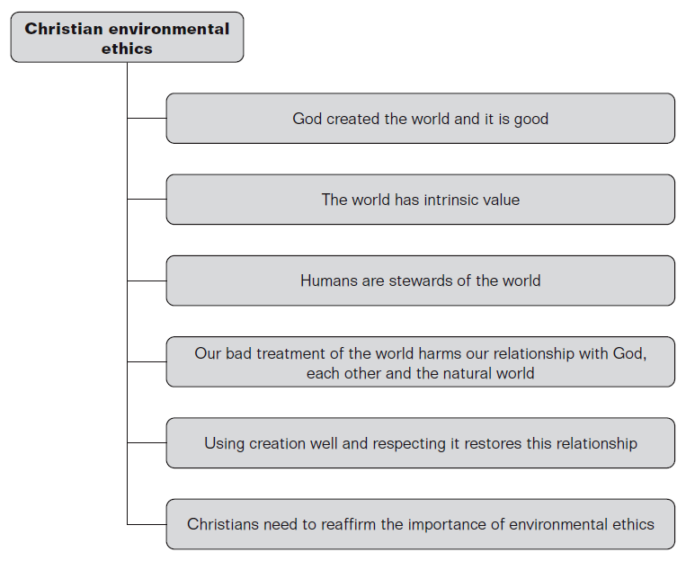
The religious approach to environmental ethics

Slide 12
Philosophical approaches to the environment
In the 1960s the Australian writer Alan Marshall wrote that there have been three main ethical approaches to the environment:
libertarian extension or deep ecology
ecologic extension or eco-holism (including the Gaia hypothesis
conservation ethics or shallow ecology.

Slide 13
Libertarian extension – deep ecology
This really began in 1949 when Aldo Leopold’s book Sand County Almanac was published shortly after his death. This inspired a new approach to the environment and an interest in ecology as a science.
The book is a mixture of natural history and philosophy, and calls for a new approach to the environment:
‘A thing is right when it tends to preserve the integrity, stability, and beauty of the bionic community. It is wrong when it tends otherwise.’
Leopold stated that we need to develop an ethics to deal with humans’ relationship to land, animals and plants, and to extend our social conscience from people to land, and that it is not right to see the natural world simply in terms of its economic worth to humans.

Slide 14
Ecologic extension – eco-holism
This emphasises not the rights of humans but the interdependence of all ecosystems and sees the environment as a whole entity, valuable in itself.
This is often known as eco-holism and its most popular form is James Lovelock’s Gaia hypothesis.

Slide 15
Business ethics
Business ethics considers the ethical relationship between businesses and consumers, between businesses and their employees.
It also considers the impact of globalisation on the environment, and on society at large.

Slide 16
Business ethics
Ethicists do not always agree about the purpose of business in society – some see the main purpose of business is to maximise profits for its owners or its shareholders.
Others consider that businesses have moral responsibilities to their stakeholders; including employees, consumers, the local community and even society as a whole.
Other ethicists have adapted social contract theory (Hobbes, Locke and Rousseau) to business, so that employees and other stakeholders are given a voice as to how the business operates.

Slide 17
Business ethics
Ethics in business and corporate social responsibility are becoming crucial.
There are many reasons for this, driven by the social, political and economic developments in the world.
Consumers have shown their dissatisfaction through taking to the streets, and there have been riots across the world bringing together many different types of activists and protestors campaigning on a variety of business related issues from globalisation and human rights to third world debt.

Slide 18
Benefits of ethics for business
One of the main benefits for a business of behaving ethically is that a better image is given to the world at large, and especially to consumers, resulting in greater profit.
It also means that expensive and potentially embarrassing public relation disasters are avoided.
As far as employees are concerned, if the business is seen to behave ethically, for example with regard to the environment, it will recruit more highly qualified employees, and this leads to better employee motivation as the employees are proud of their jobs.

Slide 19
Problems of ethics for business
Being ethical can increase costs for the business, e.g. they have to pay reasonable wages to all employees.
If a business is truly putting its ethics into practice it will have to pass on the same standards down the supply chain and this will mean no longer doing business with suppliers who are not prepared to meet the same standards.
However, businesses are products of the society in which they operate, and if society does not always have clear standards it is not always easy for a business to decide what to do.

Slide 20
Christianity and business ethics
The Bible gives guidelines that can easily be applied to the ethical issues surrounding business.
The Old Testament contains laws and injunctions about the fair treatment of employees, e.g. Leviticus 19:13; about justice, honesty and fairness in business, ‘Do not steal’; and laws about just weight, e.g. Deuteronomy 25:13–15, giving the full amount for fair payment.
The prophets, especially Amos, spoke out about the unfair treatment of the poor by the rich.
People are told to treat others as they would be treated.

Slide 21
Christianity and business ethics
Protestant social teaching has pulled in two different directions:
the individualistic approach concerned with the individual’s calling and personal integrity, so a businessman could be praised for his charity;
the concern about the competitive individualism of capitalism and the great social inequalities that it brought about, so social solutions were offered.

Slide 22
Christianity and business ethics
Catholic thought has never been very individualistic and from very early on addressed the problems of modern industrial life.
The encyclicals Rerum Novarum in 1891, Laborem Exercens in 1981 and Centesimus Annus in 1981 recognised the needs of workers, argued for trade unions and for the protection of the needs of poor countries to correct the defects of the world market.
The idea of the common good, of solidarity, is a basic value in Catholic social teaching.

