Slide 1
11. Meta-ethics – The Language of Ethics

Slide 2
What is meta-ethics?
The word ‘meta’ in Greek means ‘above’ or ‘beyond’; thus meta-ethics goes further than ethical theories to look at what is meant by the terms used in ethics what does the language mean?
Many would say that if we do not know what we are talking about, there is no point to ethical debate.
Meta-ethics differs from normative ethics, which decides which things are good and bad and gives us a guide for moral behaviour.
The theories of Natural Moral Law, Utilitarianism and Kantian ethics are examples of normative ethics.
Meta-ethics is about normative ethics and tries to make sense of the terms and concepts used.

Slide 3
What is meta-ethics?
You often hear people say something is ‘good’ or ‘bad’ or ‘right’ or `wrong’ – but what do they mean?
Are they simply expressing opinions or are they stating matters of fact?
Can we really tell right from wrong?
Many people would answer this by saying that stating what is believed to be right and wrong is essential for any discussion about our behaviour.
If this were not the case then we could never have any meaningful discussion about morality.
Thus for many people ethical language is about facts which are either right or wrong.

Slide 4
Cognitive theories of meta-ethics
Cognitivism is the view that we can have moral knowledge.
People who hold cognitive theories about ethical language believe that ethical statements are about facts and can be proved true or false.

Slide 5
Cognitive theories of meta-ethics

Slide 6
Ethical naturalism
This theory holds that all ethical statements are the same as non-ethical (natural) ones – they are all factual and can, therefore, be verified or falsified.
So ‘Thomas More was executed for his beliefs in 1535’ and ‘Thomas More was a good man’ can both be proved true or false by looking at the evidence.

Slide 7
Ethical naturalism
The first statement is factual, and can be determined by looking at evidence: eyewitness accounts, death certificate and so on.
The ethical naturalists would claim that we can do the same for the second statement by establishing if, in his personal behaviour, Thomas More was good, kind, unselfish, caring; or by looking at whether his actions had good consequences.
If we find supporting evidence we can conclude that ‘Thomas More was a good man’ and, if not, then the statement is false.

Slide 8
Ethical naturalism

Slide 9
Criticisms of ethical naturalism – the naturalistic fallacy
In Principia Ethica (1903), G.E. Moore argued against ethical naturalism and called the attempt to identify goodness with a natural quality a mistake.
He said that to claim that moral statements can be verified or falsified using evidence is to commit the naturalistic fallacy.
He based his argument on David Hume, who thinks that to derive an ‘ought’ from an ‘is’ is logically invalid.

Slide 10
Intuitionism – G.E. Moore
G.E. Moore said that good is a simple, unanalysable property, just as a primary colour is.
Moore adapted a version of Utilitarianism in that he said that right acts are those that produce the most good, but he said that goodness cannot be identified with some natural property such as pleasure: goodness cannot be defined.

Slide 11
Intuitionism – G.E. Moore
We know what ‘yellow’ is and can recognise it whenever it is seen, but we cannot actually define yellow.
In the same way, we know what good is but we cannot actually define it. (Moore, Principia Ethica)

Slide 12
Intuitionism – G.E. Moore

Slide 13
Intuitionism – H.A. Prichard
Prichard discusses the moral claim ‘ought’ by saying that no definition can be given to this word, but, like Moore's idea about ‘good’, we all recognise its properties – everyone recognises when we ought to do a certain action, so moral obligations are obvious.
Prichard thought there were two types of thinking – reason and intuition. Reason looks at the facts of a situation and intuition decides what to do.

Slide 14
Intuitionism – H.A. Prichard

Slide 15
Intuitionism – W.D. Ross
Ross fleshed out the bare bones of intuitionism found in Prichard, and, while acknowledging his debt to Moore and Prichard and agreeing that ‘right’ and ‘obligatory’ are as indefinable as ‘good’, he was a deontologist, arguing that it was obvious that certain types of actions, which he called prima facie duties, were right.
In any particular situation we would come to recognise certain prima facie duties.

Slide 16
Intuitionism – W.D. Ross
Ross listed seven classes of prima facie duties:
duties of fidelity (e.g. promise-keeping)
duties of reparation – when we have done something wrong
duties of gratitude
duties of justice
duties of beneficence – helping others
duties of self-improvement
duties of non-maleficence – not harming others.

Slide 17
Intuitionism – W.D. Ross
Ross says that when these prima facie duties conflict, we must follow the one we think is right in the situation, and sometimes one prima facie duty will have to give way to another – that is why Ross called them prima facie duties: they are duties at first sight.

Slide 18
Intuitionism – W.D. Ross

Slide 19
Criticisms of intuitionism
This idea of knowing what is good by intuition and not by any empirical evidence is not proved conclusively by Moore – he says you either agree with him or you have not thought about it properly.
However, it would seem that if the naturalistic fallacy shows that you cannot infer value judgements from natural facts by means of evidence obtained through the senses, then the introduction of ‘non-natural’ facts and a special ‘intuition’ simply shrouds the whole issue in mystery.

Slide 20
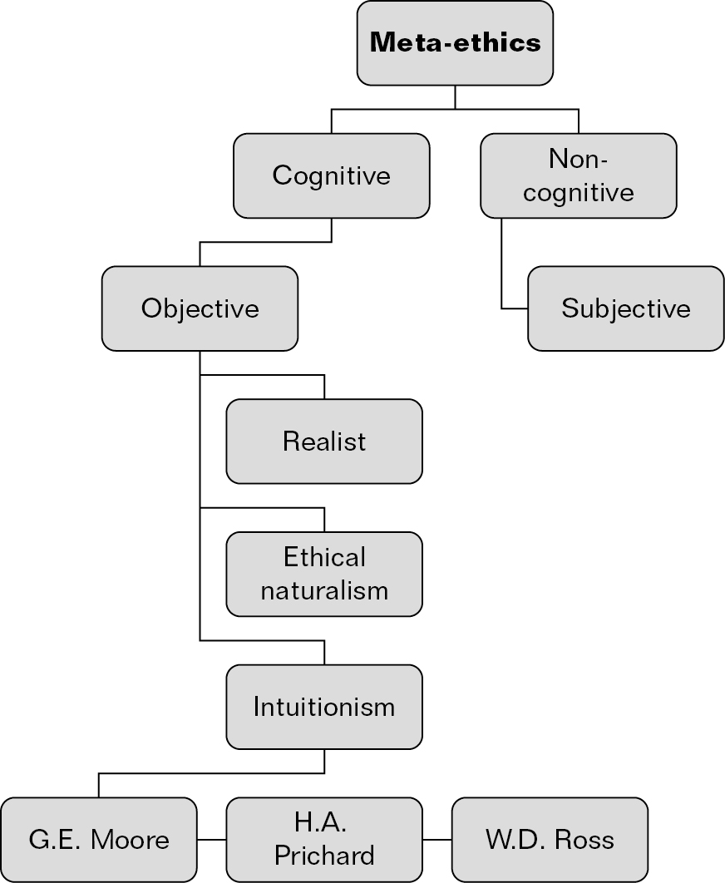
Meta-ethics

Slide 21
Non-cognitive theories of meta-ethics
Non-cognitivism says that there is no ethical knowledge, because ethical statements are not statements that can be proved true or false.
Thus to say ‘Euthanasia is wrong’ is not a statement about facts, but some other kind of saying.
Non-cognitivists make a distinction between facts and values.

Slide 22
Emotivism – A.J. Ayer
Emotivists take a completely different view on moral statements and start from the premise that there is no ethical knowledge because ethical judgements are not the kinds of statements that can be true or false.
Emotivism will not tell you how to live a moral life, but simply helps us understand moral statements: as action guiding and as conveying certain attitudes.
A.J. Ayer said: ‘ethical terms do not serve only to express feelings. They are calculated also to arouse feeling, and so to stimulate action.’

Slide 23
Emotivism – A.J. Ayer
Emotivism has its roots in the Vienna Circle, a group of philosophers in the 1920s who developed a theory called logical positivism which holds roughly that any truth claim must be tested by sense experience (the verification principle).
Ethical statements cannot be tested by sense experience, so they are not genuine truth claims and can only express feelings.

Slide 24
Emotivism – A.J. Ayer
A.J. Ayer, in his book Language, Truth and Logic (published in 1935 when he was just 25 years old), stated briefly that there are only two kinds of meaningful statements:
analytic statements – the truth or falsity of the statement can be determined simply by understanding the terms that occur in them (e.g. ‘all bachelors are unmarried men’). Examples of analytic statements are statements of mathematics or logic.
synthetic statements – the truth or falsity of the statement can be determined by checking to establish the facts either way. Examples of synthetic statements are statements of science, history and ordinary life.

Slide 25
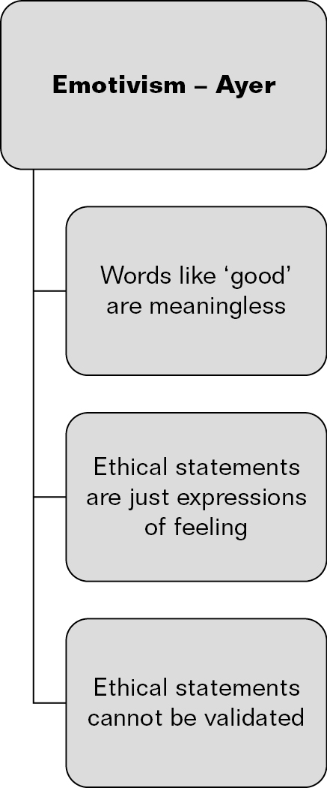
Emotivism – A.J. Ayer

Slide 26
Emotivism – C.L. Stevenson
C.L. Stevenson gave a more detailed version of emotivism in his book Ethics and Language (1944).
Stevenson did not use the verification principle, but discussed the emotive meaning of words – many moral terms (e.g. ‘honesty’, ‘respect’, ‘steal’, ‘murder’) are both descriptive and emotive, expressing also what we feel about them.
So when an individual is making a moral judgement they are not only giving vent to their feelings, but they are also trying to influence others’ attitudes.

Slide 27
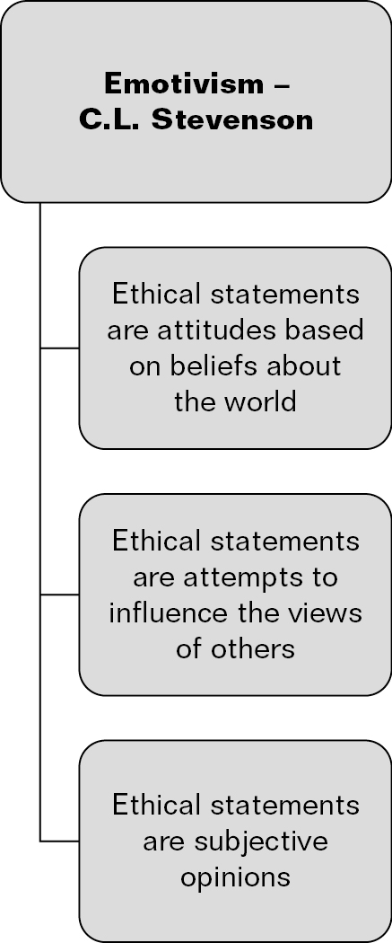
Emotivism – C.L. Stevenson

Slide 28
Criticisms of emotivism
When criticising emotivism, it is important to remember that it does not purport to be an ethical theory, but is simply an analysis of the nature and content of ethical language.
It starts from the basis of logical positivism and so removes any factual content from ethical language.
However, as Rachels points out, moral judgements appeal to reason; they are not just expressions of feeling.
So whereas the statement ‘I like orange Smarties’ needs no reason, moral judgements do, or else they are arbitrary.

Slide 29
Prescriptivism – R.M. Hare
Both Ayer and Stevenson based their views on the distinction between facts and values, which Hume had already claimed made it impossible to deduce a prescriptive statement (an ‘ought’) from a descriptive statement (an ‘is’).
Hare attacked this distinction and attempted to show that ethical language is essentially prescriptive; the role of ethical statements is to say what ought to be done and such prescriptions are moral because they are universal.

Slide 30
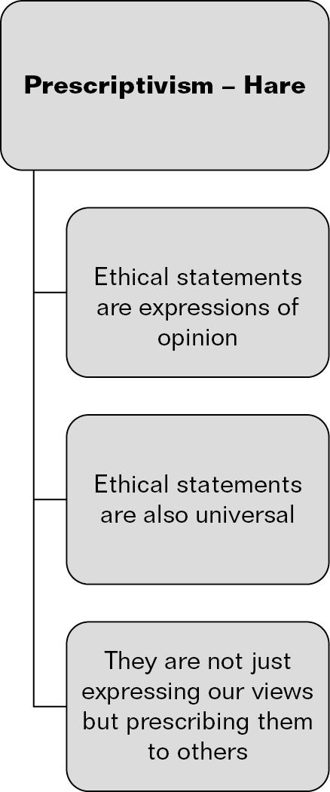
Prescriptivism – R.M. Hare

Slide 31
Criticisms of prescriptivism
Prescriptivism says that ‘ought’ judgements are universalisable prescriptives or imperatives and not truth claims – they are not objective and there is no moral knowledge or moral truth.
This goes against the way people approach ethics in their daily lives – in general people do think it is wrong to steal, lie, kill the innocent, rape and so on.
According to Hare, we could just as easily choose the opposite if we wished and we could change our moral principles as we choose or as our circumstances alter.

