Slide 1
1. What Is Ethics?

Slide 2
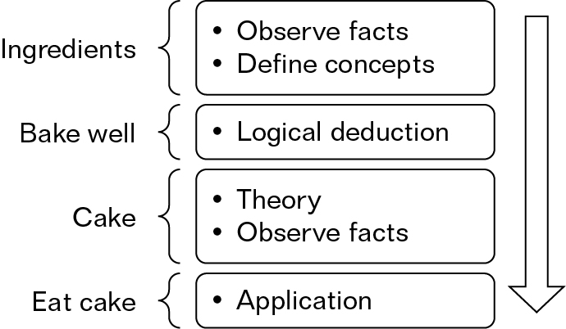

Slide 3
Fallacies
‘Is-ought fallacy’
David Hume (1711–1776) observed that often when people debate a moral issue they begin with facts and slide into conclusions that are normative; that is, conclusions about how things ought to be. He argued that no amount of facts taken alone can ever be sufficient to imply a normative conclusion: the is–ought fallacy.

Slide 4
Meta-ethics
looks at the meaning of the language used in ethics
Normative ethics
attempts to arrive at practical moral standards that tell us right from wrong
Applied Ethics
The application of theories of right and wrong and theories of value to specific issues

Slide 5
Normative ethics
Deontological ethics
certain actions are right or wrong in themselves regardless of the consequences
Teleological ethics
looking at the consequences or results of an action to decide if it is right or wrong

Slide 6
Ethical theories
Utilitarianism
Kantian ethics
Cultural relativism
Divine Command
Natural Moral Law
Religious Ethics
Virtue Ethics

